Slide 1




‘To Spam or Not to Spam: The Rise of Speculative MEV Bots
Christof Ferreira Torres
christof.torres@tecnico.ulisboa.pt
Decentralized Finance & Crypto Workshop January 26-28 2026, Scuola Normale Superiore, Pisa, Italy

Slide 2
MEV
…2020

Slide 3
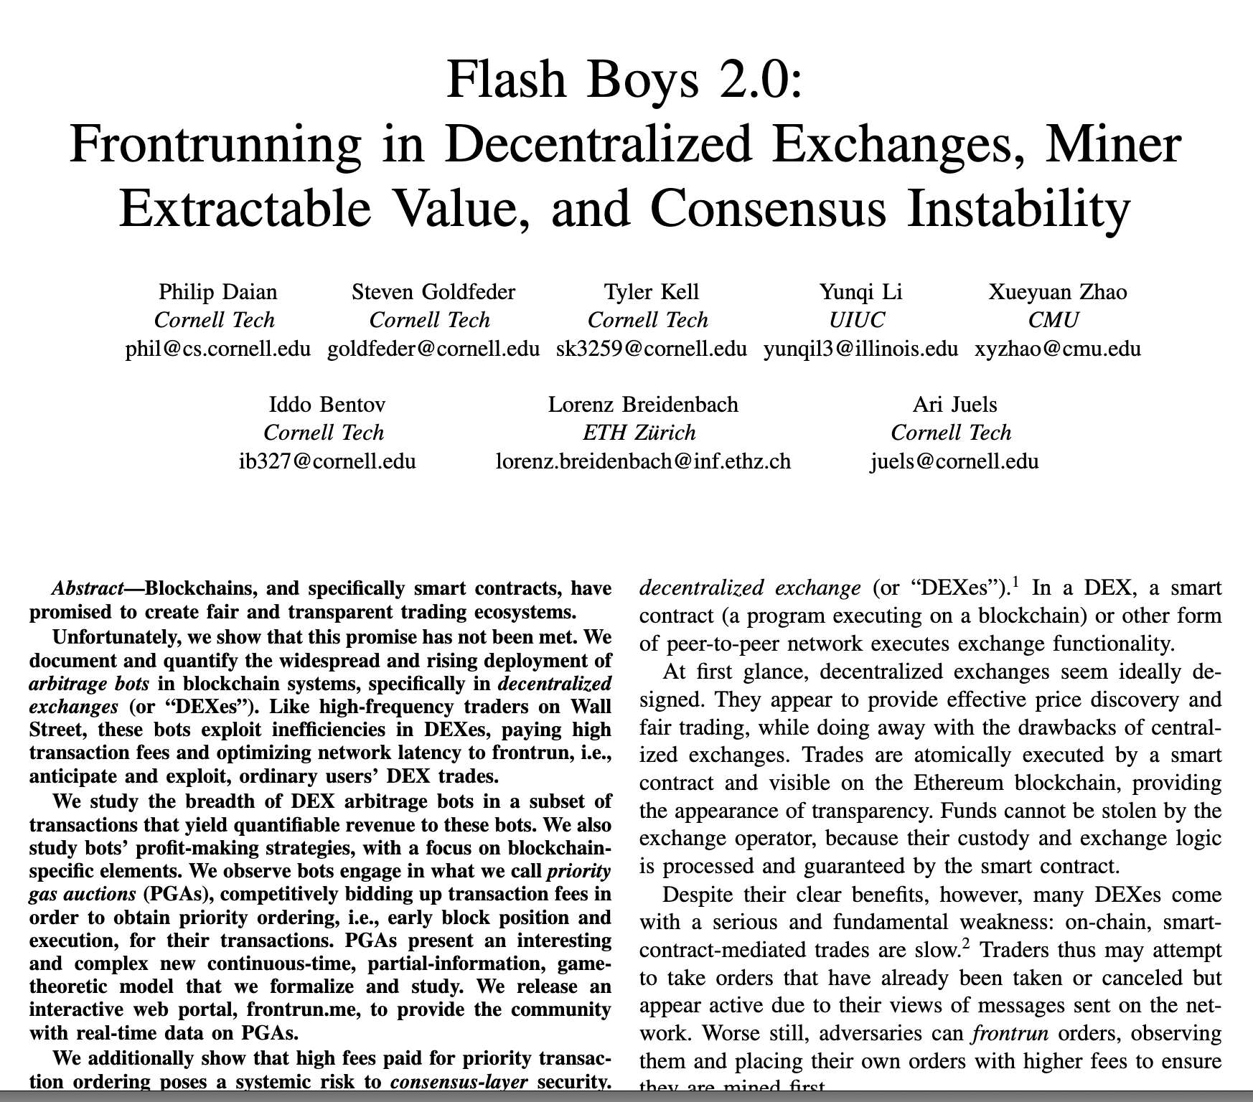
Miner Maximal Extractable Value
Any value (monetary profit) that you can extract by manipulating the order of transactions.
3

Slide 4
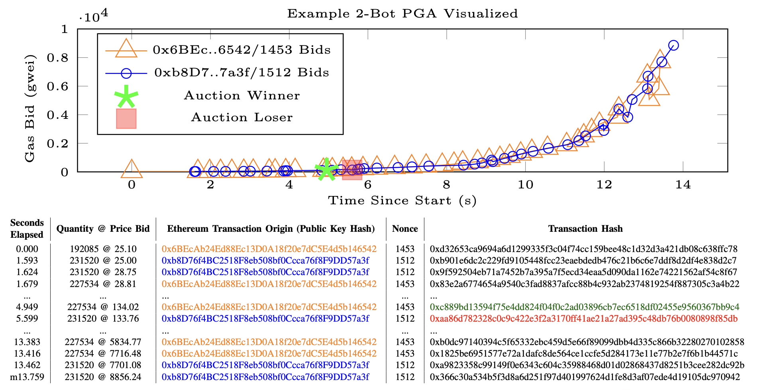
Priority Gas Auctions (PGAs)
Daian, Philip, et al. "Flash boys 2.0: Frontrunning in decentralized exchanges, miner extractable value, and consensus instability." 2020 IEEE symposium on security and privacy (SP). IEEE, 2020.
4

Slide 5

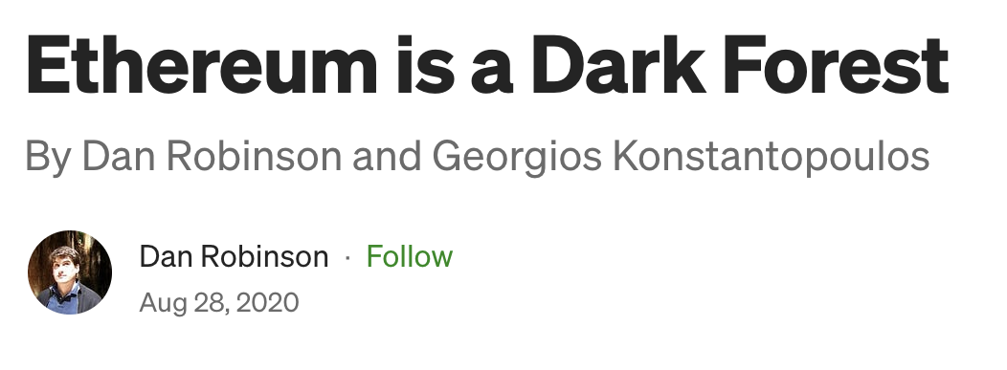
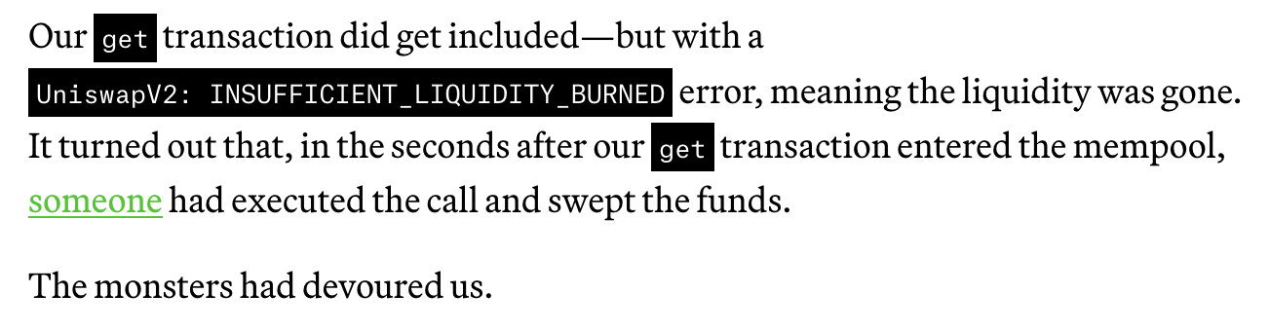
The Dark Forest
5

Slide 6


Transaction Ordering on Ethereum
Miner (Validator/Builder)
T₁
T₂
T₄
T₃
T₂
Block gas limit
…
T₄
T₁
User
T₅
n
n-1
n-2
Orders based on profit
Mempool
(Pending Transactions)
Proposed Block
6

Slide 7
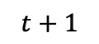
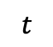
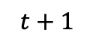
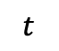
MEV Primitives
Frontrunning
Backrunning
T₁
T₁
T₁
T₁
T_{V}
T_{A}
T_{V}
T_{V}
T₂
T_{V}
T₂
T_{A}
Execution Order
T₃
T₂
T₃
T₂
T₃
T₃
$$t$$
$$t+1$$
$$t$$
$$t+1$$
Mempool
(Pending Transactions)
Proposed Block
7

Slide 8

MEV Strategies
Frontrunning
+
Backrunning
Backrunning
Arbitrage
Liquidation
Sandwiching
8

Slide 9
Negative Side Effects of MEV
$0.50
$4.00
$3.98
$3.95
…
…
…
…
High Transaction Fees
(e.g., priority gas auctions)
Block Congestion (Spam)
(e.g., accumulation of failed bot transactions)
$1.20
$1.80
…
…
Price Manipulation
(e.g., frontrunning / sandwich attacks)
Consensus Instability
(e.g., uncle-bandit / time-bandit attacks)
9

Slide 10
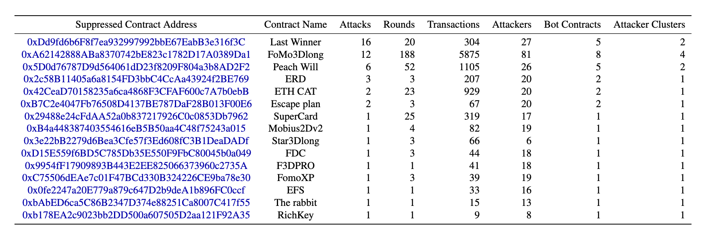
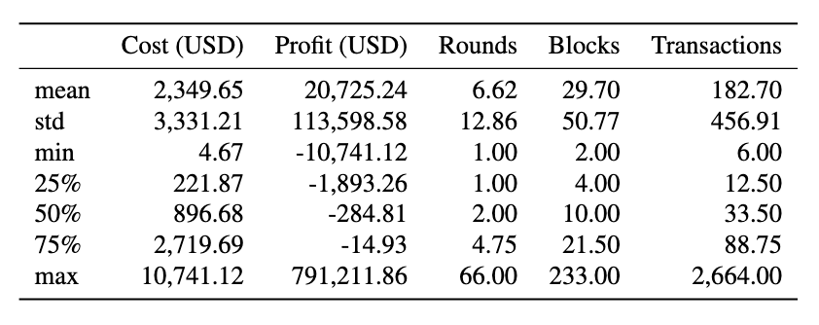
Block Stuffing (aka Spam)
Ferreira Torres, Christof, et al. "Frontrunner jones and the raiders of the dark forest: An empirical study of frontrunning on the Ethereum blockchain." 30th USENIX Security Symposium (USENIX Security 21). 2021.
10

Slide 11
Private Mempools
…2021

Slide 12

Flashbots
* Open-source project: https://github.com/flashbots
Flashbots* is an organization that aims to mitigate the negative externalities of MEV:
Frontrunning
Gas price wars
Democratize MEV
Allows users to bypass the public mempool by submitting transactions “privately” via bundles
Flashbots Network
Ethereum Network
Searcher
Miner
Send bundle
Forward bundle
Searcher
Send bundle
Relay
Forward bundle
Miner
Searcher
Send bundle
Forward bundle
Miner
Public mempool
Private mempool
mev-geth
12

Slide 13
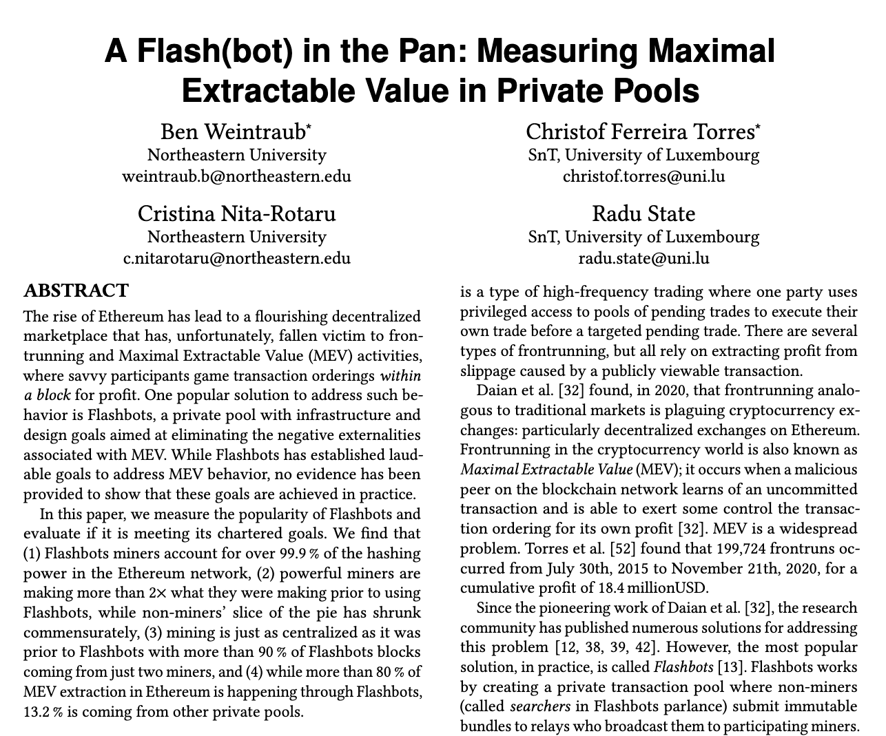
Analyzing MEV in Private Pools
13

Slide 14
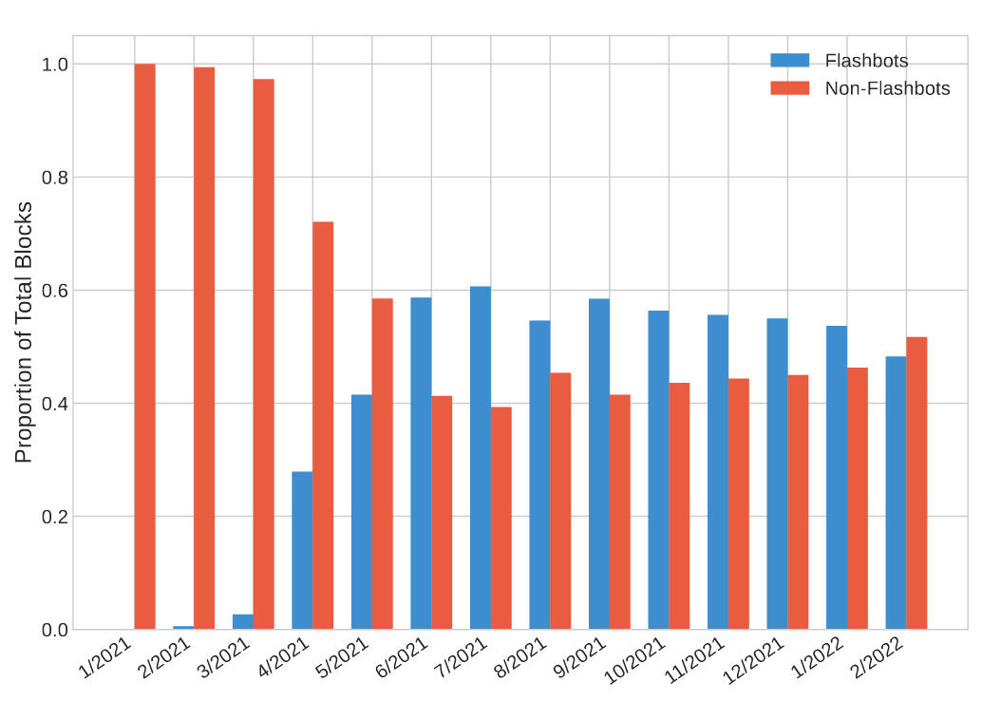
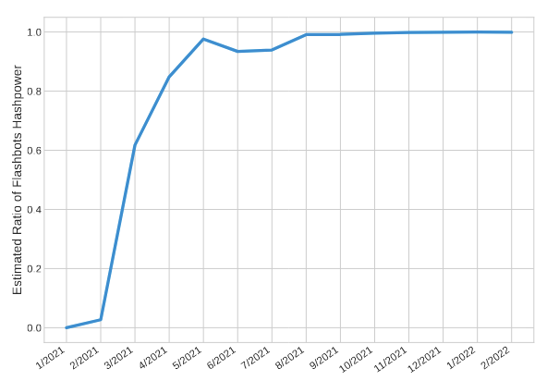
Adoption of Flashbots
After 4 months 99% of miners were using Flashbots (i.e., mev-geth)
Weintraub, Ben, et al. "A flash (bot) in the pan: measuring maximal extractable value in private pools." Proceedings of the 22nd ACM Internet Measurement Conference. 2022.
14

Slide 15
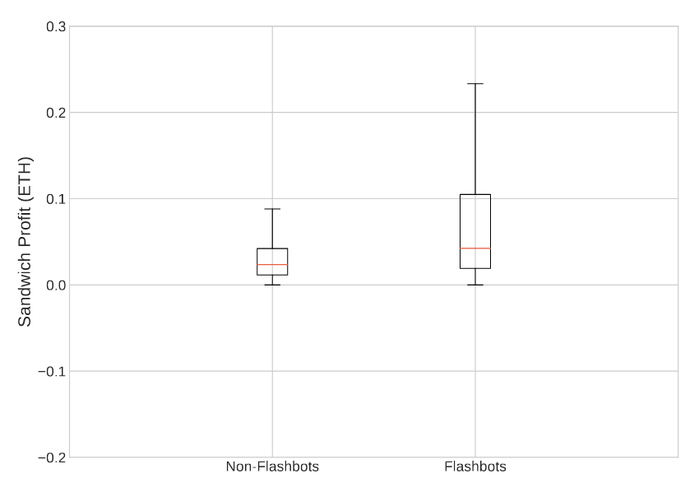
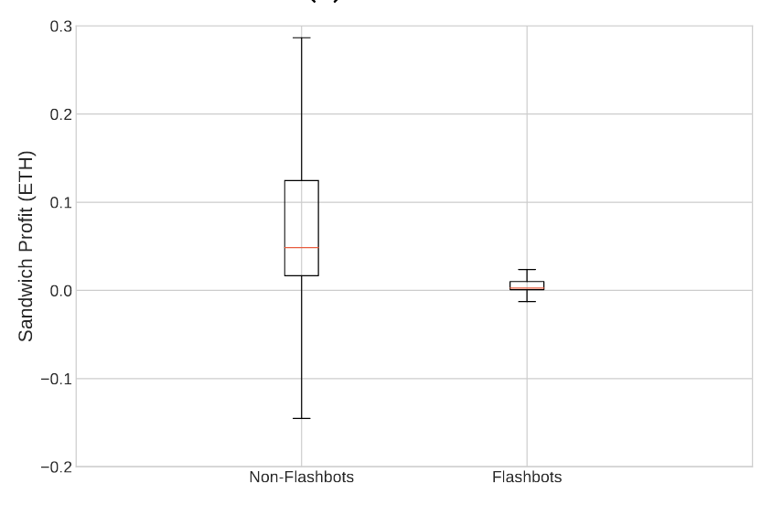
MEV Profit Distribution
Miners
Searchers (Non-Miners)
Miners were making more profit using Flashbots
Searchers are making less profit using Flashbots
Weintraub, Ben, et al. "A flash (bot) in the pan: measuring maximal extractable value in private pools." Proceedings of the 22nd ACM Internet Measurement Conference. 2022.
15

Slide 16
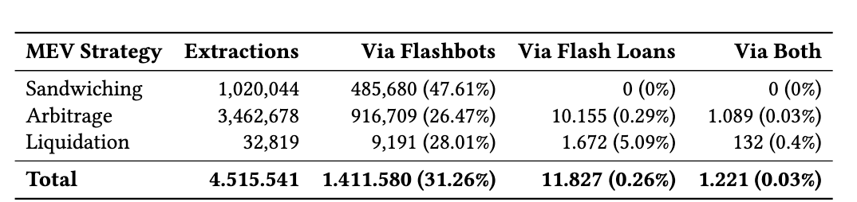
MEV Extracted Via Flashbots
Analyzed blocks between 10,000,000 and 14,444,725 (04.05.2020 – 23.03.2022)
48% of sandwiching is via Flashbots
Weintraub, Ben, et al. "A flash (bot) in the pan: measuring maximal extractable value in private pools." Proceedings of the 22nd ACM Internet Measurement Conference. 2022.
16

Slide 17
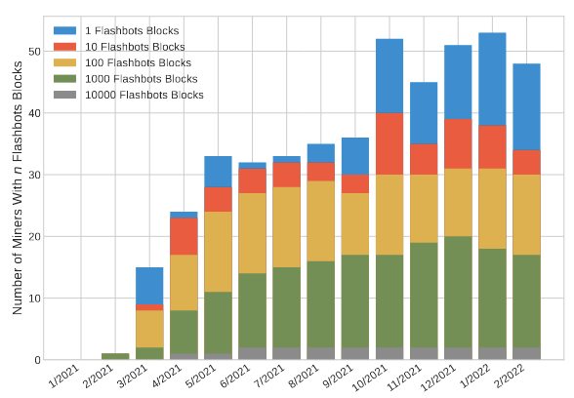
MEV Centralization
90% of Flashbots blocks were mined by 2 miners
Weintraub, Ben, et al. "A flash (bot) in the pan: measuring maximal extractable value in private pools." Proceedings of the 22nd ACM Internet Measurement Conference. 2022.
17

Slide 18
Proposer-Builder Separation
…2022

Slide 19
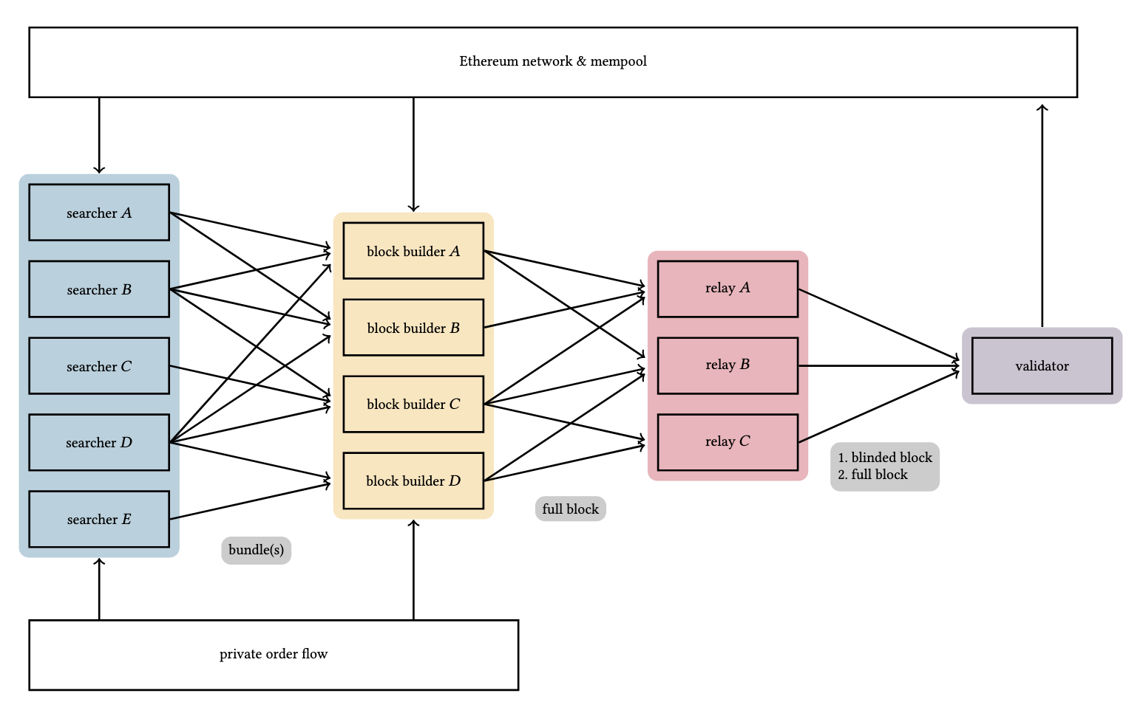
Proposer-Builder Separation (PBS)
19

Slide 20
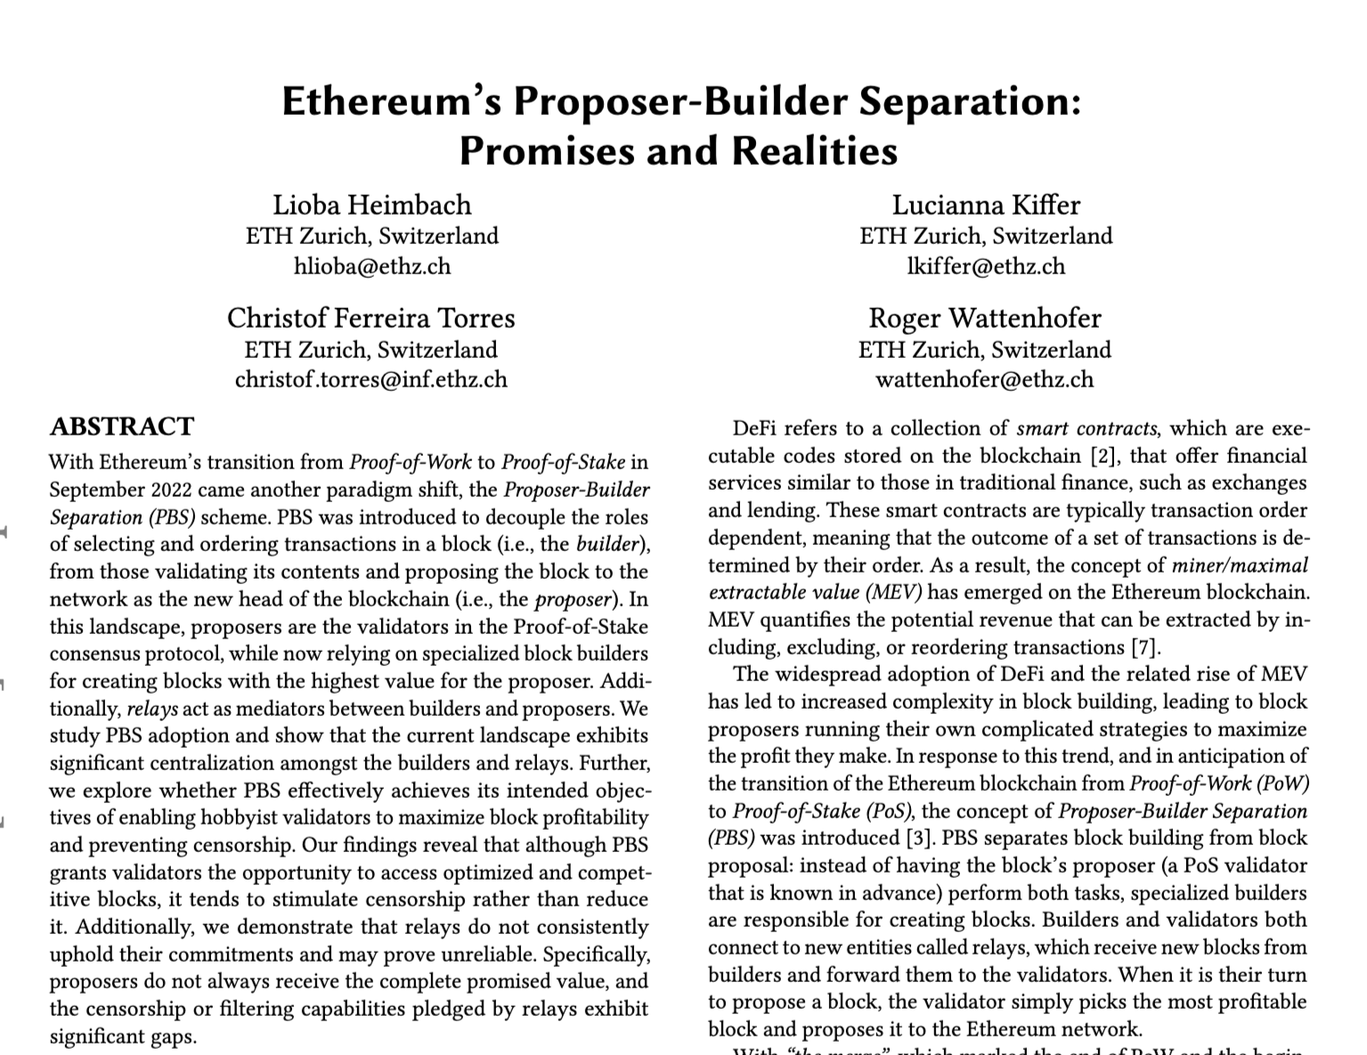
Analyzing MEV in the Era of PBS
20

Slide 21
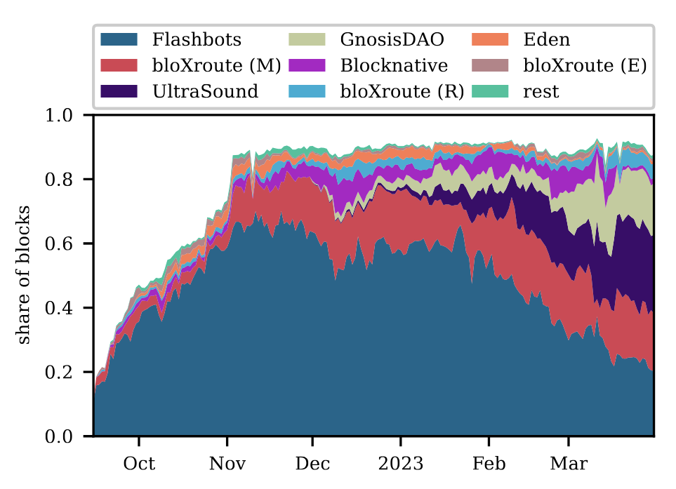
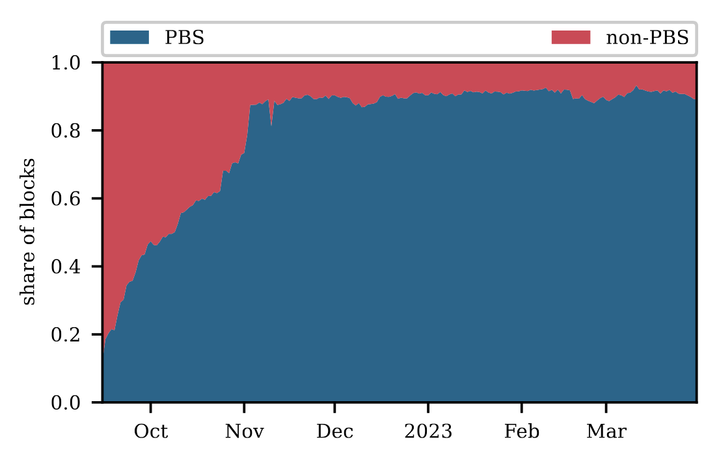
Adoption of PBS
After only 2 months over 90% of blocks are PBS blocks
~80% of blocks originate from 4 relays
Heimbach, Lioba, et al. "Ethereum's Proposer-Builder Separation: Promises and Realities." Proceedings of the 2023 ACM on Internet Measurement Conference. 2023.
21

Slide 22
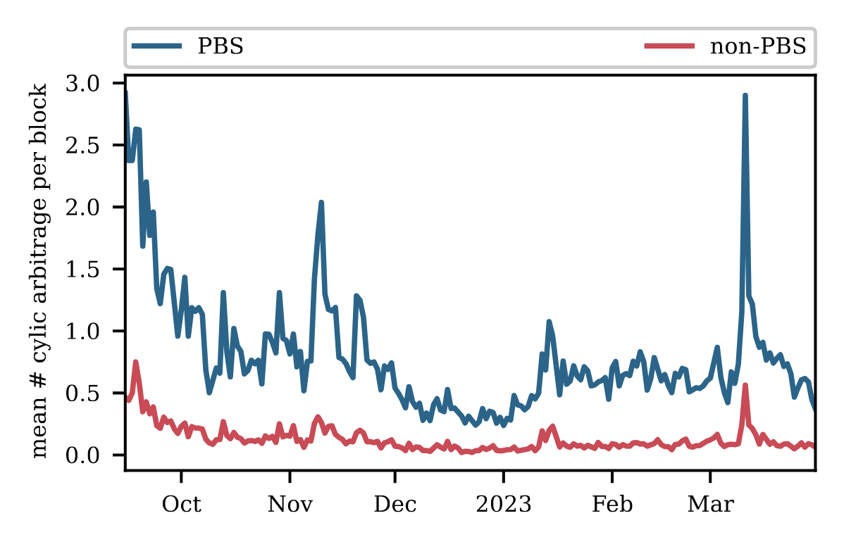
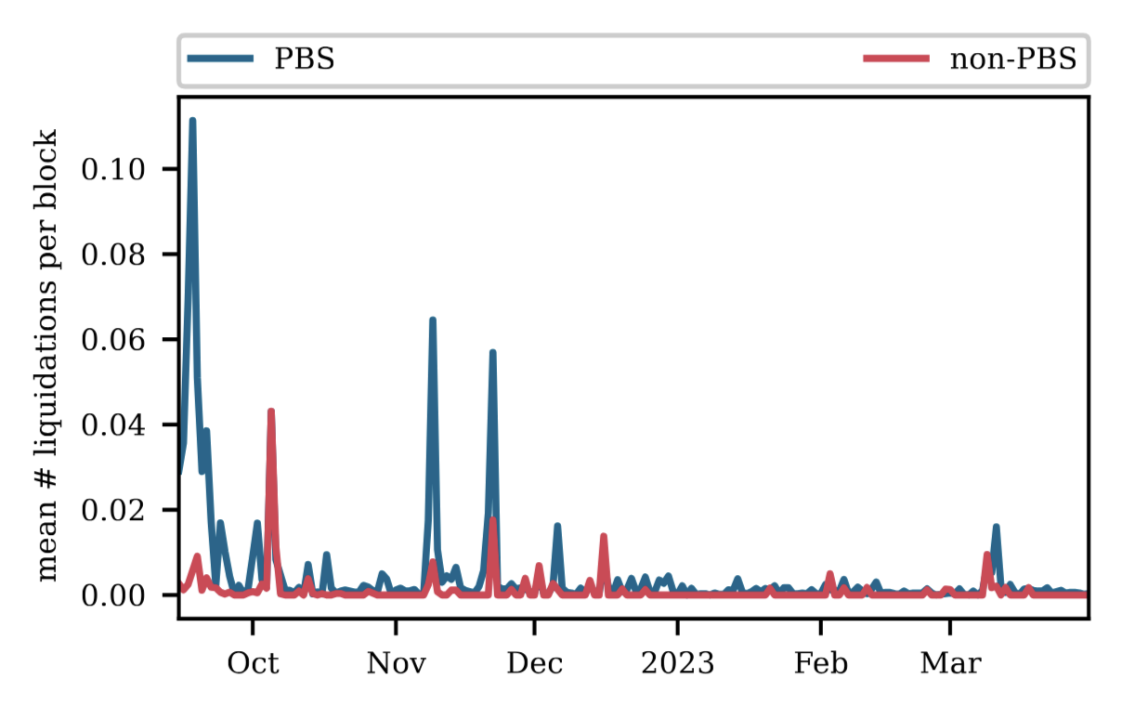
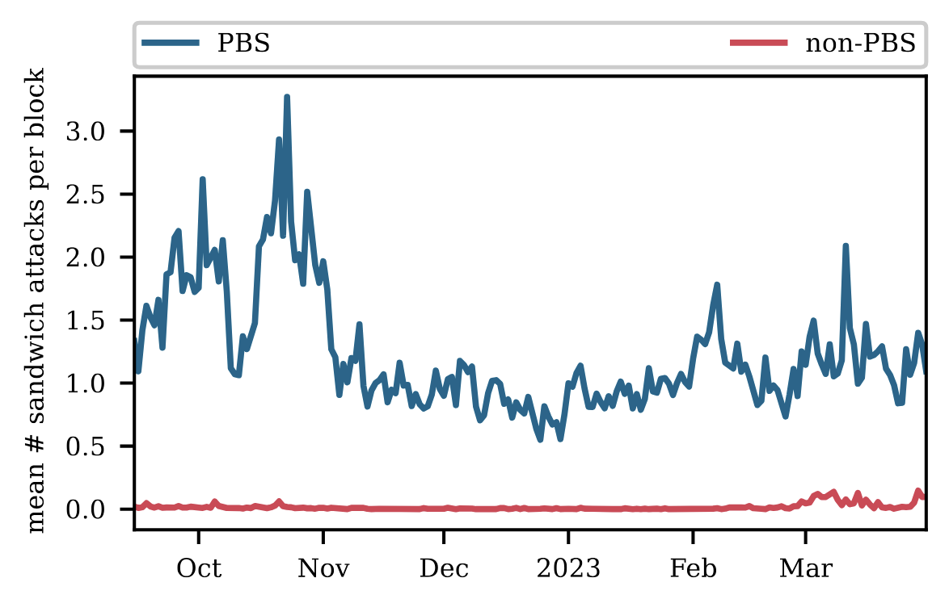
MEV Extracted via PBS
Arbitrage
Liquidation
Sandwiching
Most MEV is being extracted via PBS blocks
Heimbach, Lioba, et al. "Ethereum's Proposer-Builder Separation: Promises and Realities." Proceedings of the 2023 ACM on Internet Measurement Conference. 2023.
22

Slide 23
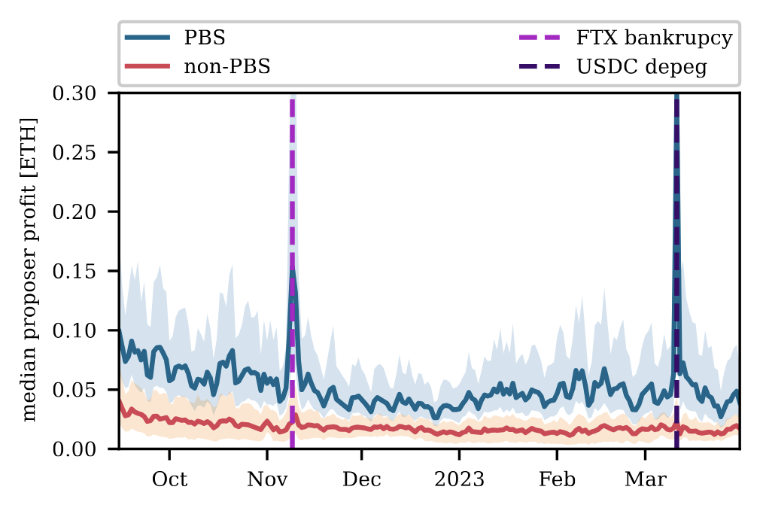
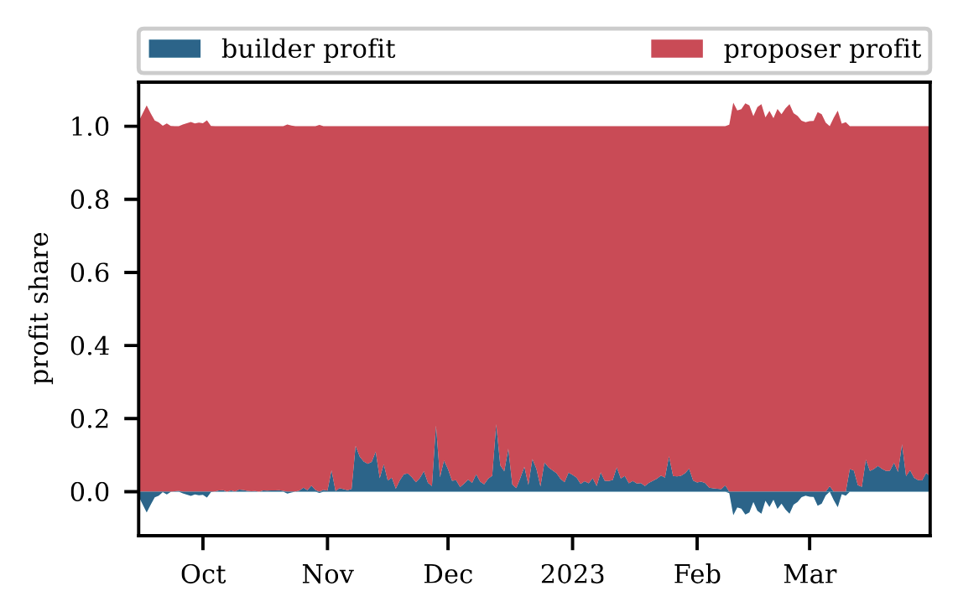
MEV Profit Distribution
Validators engaging in PBS make more profit
Proposers keep ~90% of the profit compared to builders
Heimbach, Lioba, et al. "Ethereum's Proposer-Builder Separation: Promises and Realities." Proceedings of the 2023 ACM on Internet Measurement Conference. 2023.
23

Slide 24
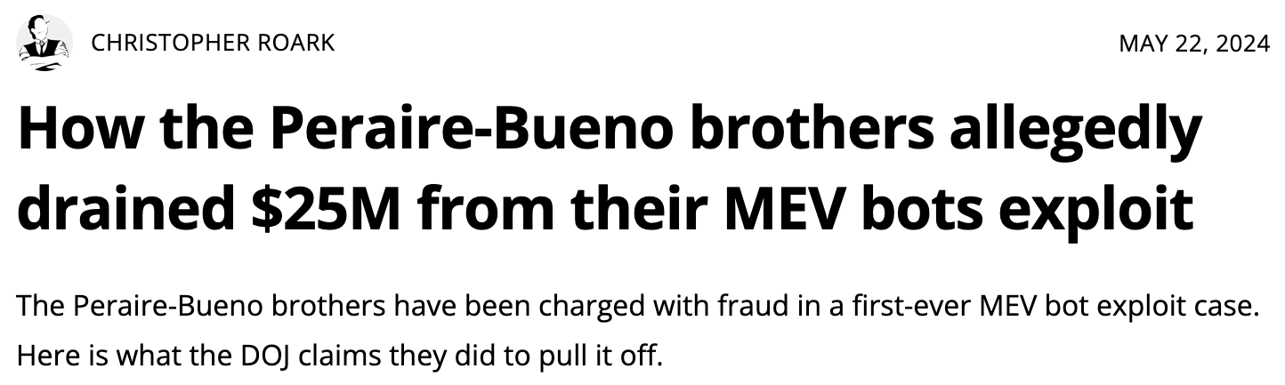
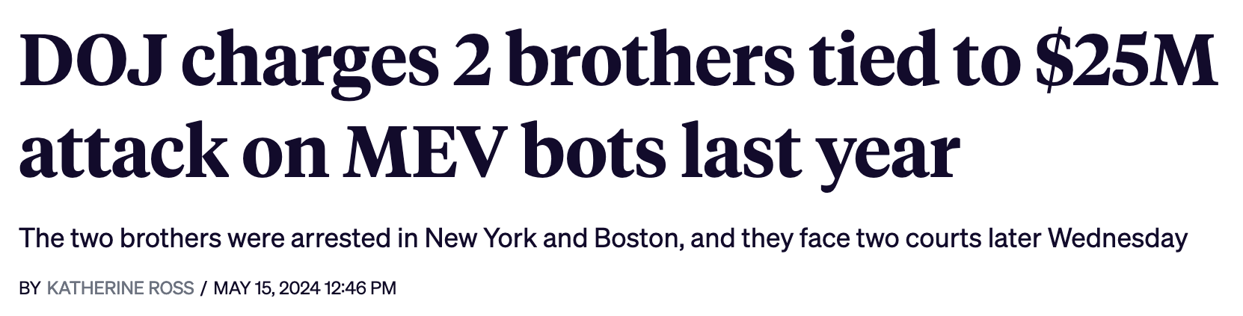
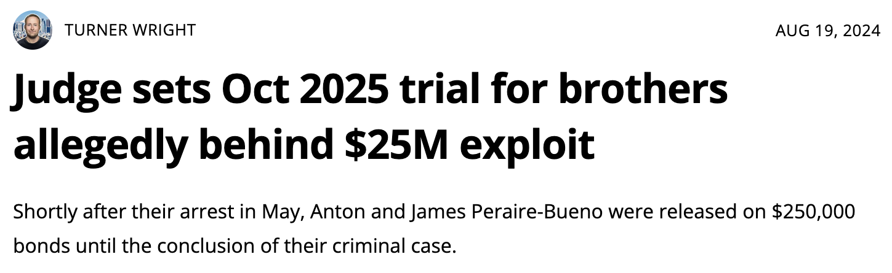
Unbundling Attacks
24

Slide 25
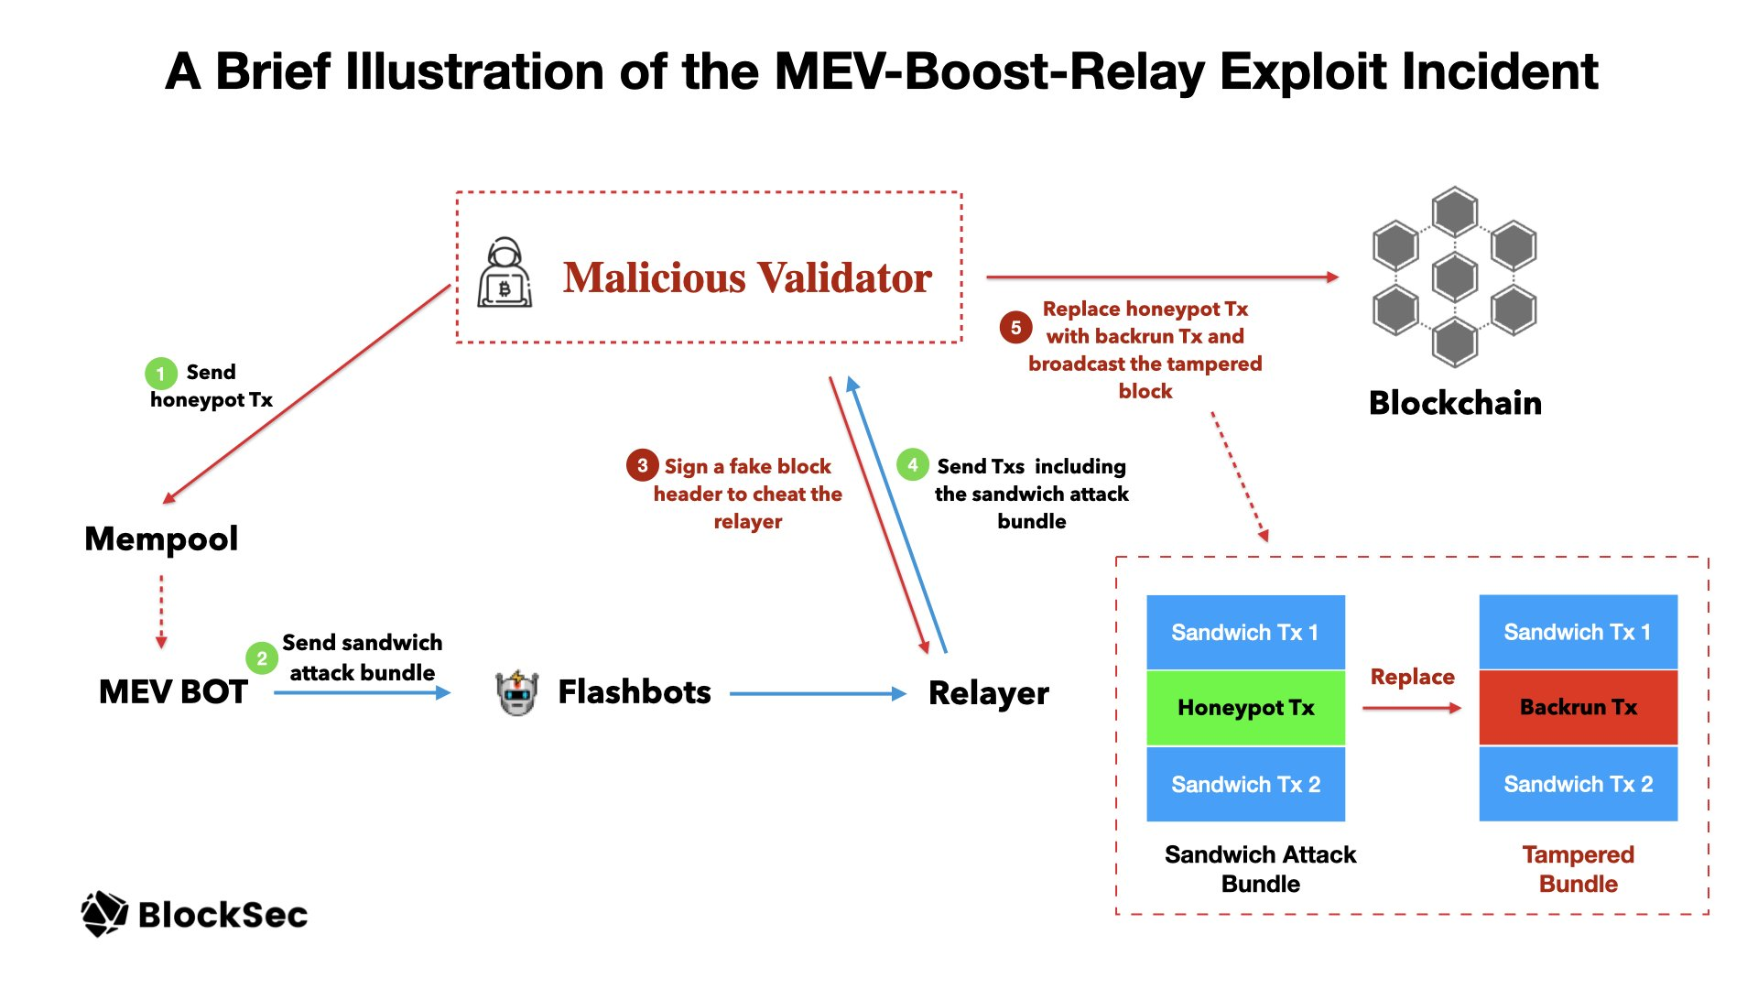
Unbundling Attacks
$25 Million Profit
25

Slide 26
Rollups
…2023

Slide 27


Rollups
…
…
…
T_{L1}
…
T_{Batch}
…
L1 Block n
L1 Block n+m
Centralized ordering
Ordering follows FCFS
No public mempool
Layer-1 ~12s
(Ethereum)
Bridge
(Smart Contract)
Layer-2 ~0.25s-2s (Rollups)
No Frontrunning
Block-based backrunning
State S₁
State S₂
T_{L2}
T_{L1}
T_{L2}
…
…
L2 Block
Sequencer
L1 Transaction
L2 Transaction
27

Slide 28
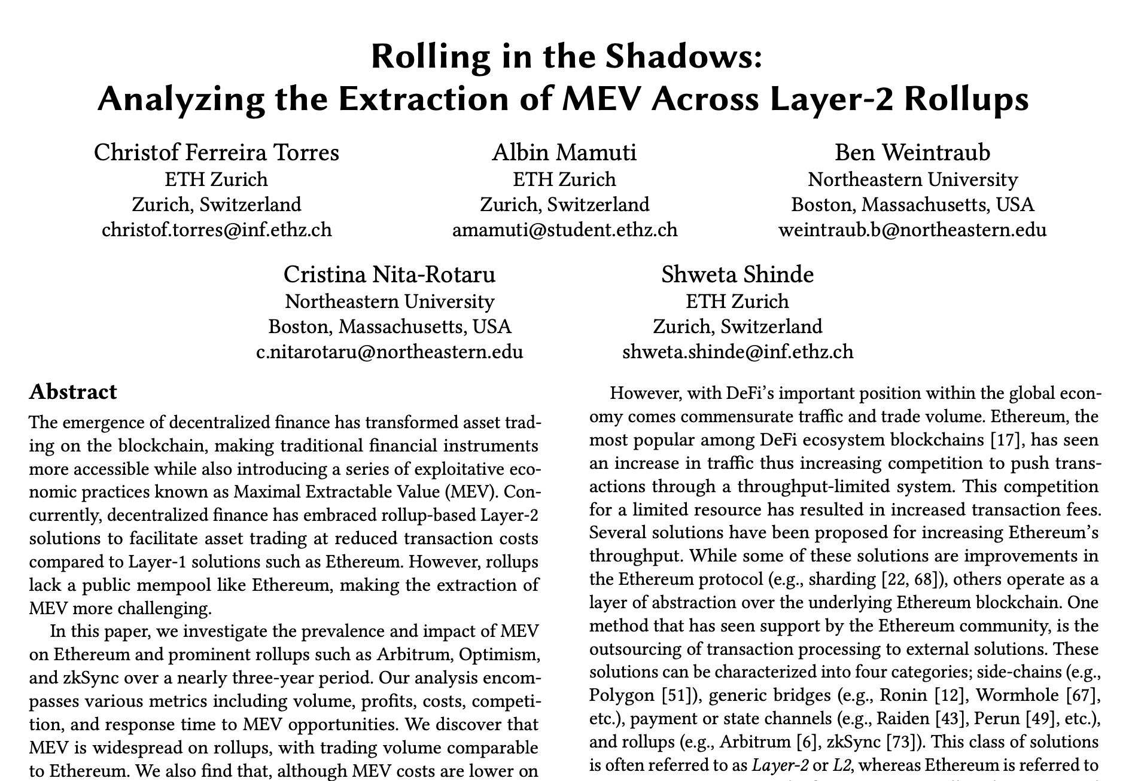
Analyzing MEV Across L1 and L2
28

Slide 29
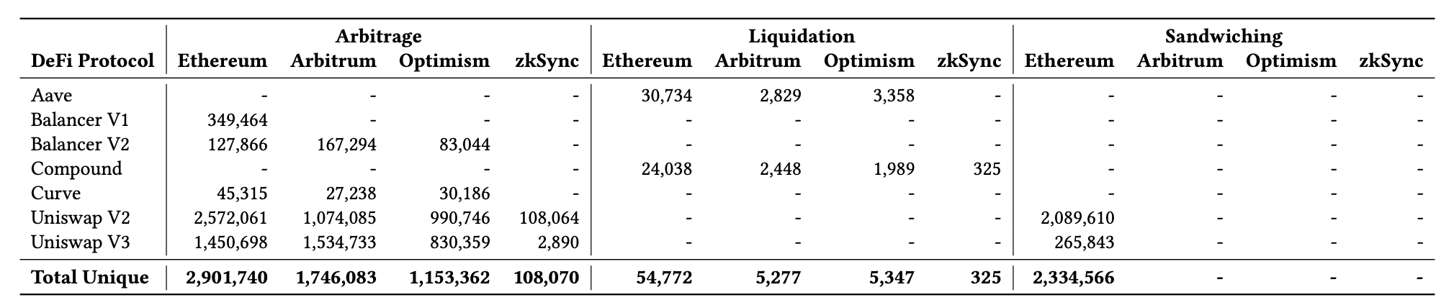
MEV Volume Across L1 and L2
Rollups have reached similar MEV volume as compared to Ethereum
We did not find any evidence of sandwiching on Rollups
Ferreira Torres, Christof, et al. "Rolling in the shadows: Analyzing the extraction of mev across layer-2 rollups." Proceedings of the 2024 on ACM SIGSAC Conference on Computer and Communications Security. 2024.
29

Slide 30
MEV Costs Across L1 and L2
MEV extraction is cheaper on rollups than on Ethereum
Ferreira Torres, Christof, et al. "Rolling in the shadows: Analyzing the extraction of mev across layer-2 rollups." Proceedings of the 2024 on ACM SIGSAC Conference on Computer and Communications Security. 2024.
30

Slide 31
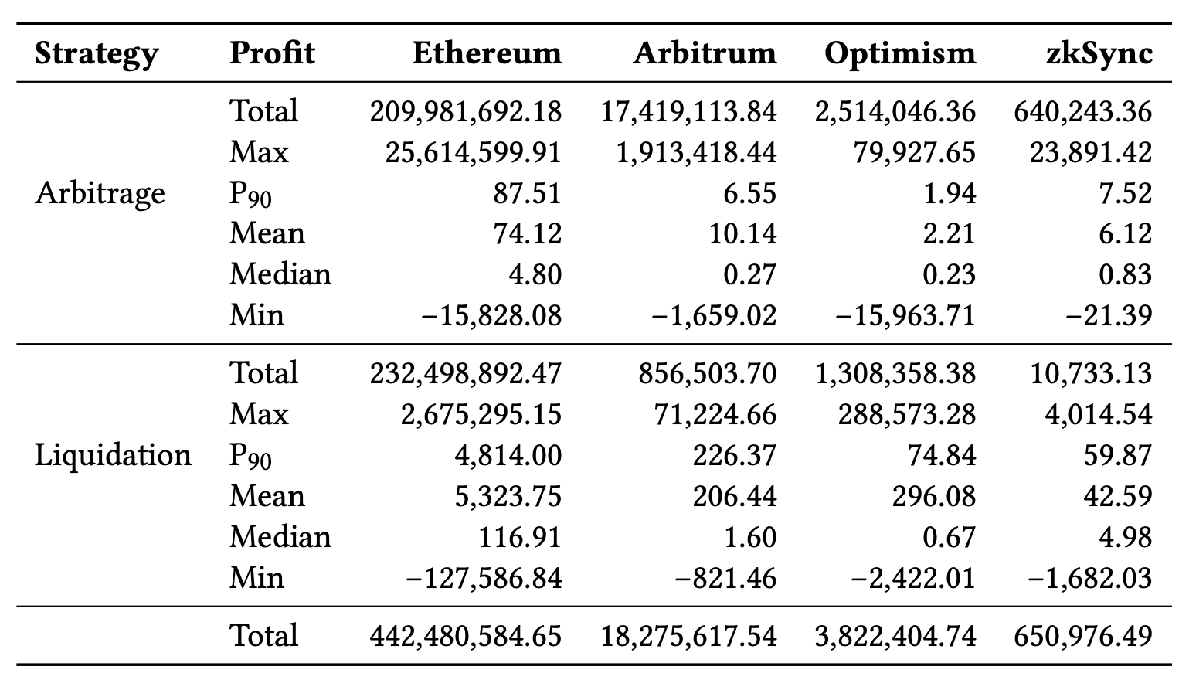
MEV Profits Across L1 and L2
MEV extraction on Ethereum is more profitable than on rollups
Ferreira Torres, Christof, et al. "Rolling in the shadows: Analyzing the extraction of mev across layer-2 rollups." Proceedings of the 2024 on ACM SIGSAC Conference on Computer and Communications Security. 2024.
31

Slide 32
MEV Opportunities Across L1 and L2
A small number of L2 users managed to extract MEV in the same block
Ferreira Torres, Christof, et al. "Rolling in the shadows: Analyzing the extraction of mev across layer-2 rollups." Proceedings of the 2024 on ACM SIGSAC Conference on Computer and Communications Security. 2024.
32

Slide 33
Speculative MEV
…2025

Slide 34
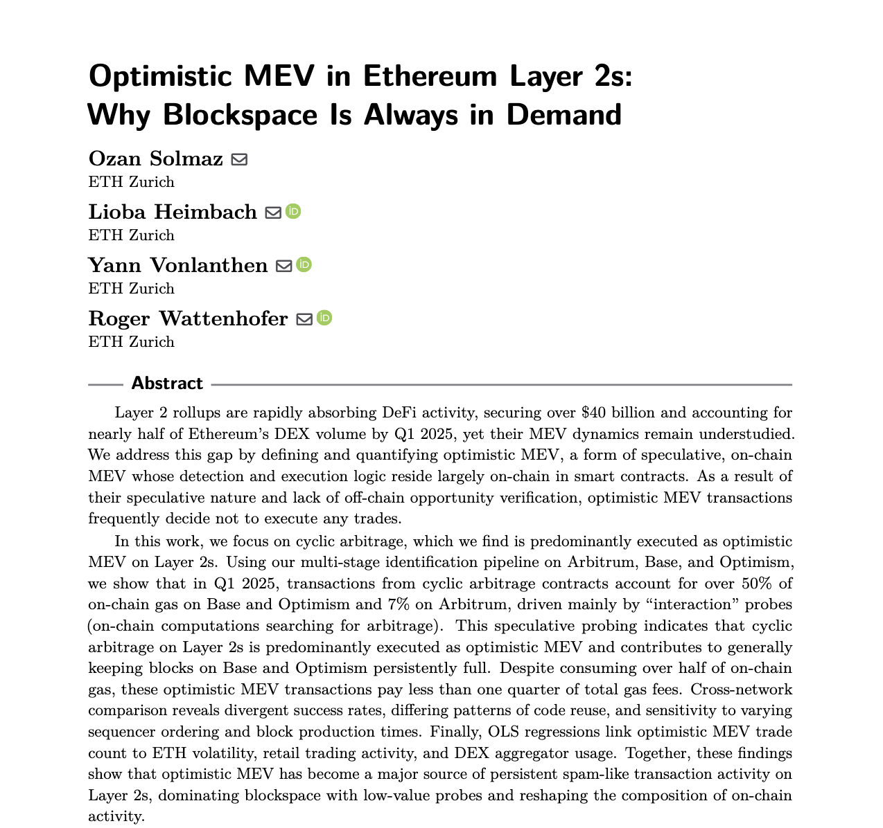
What is Speculative MEV?
34

Slide 35


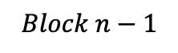
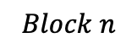
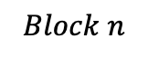
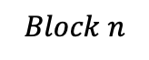
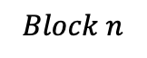
What is Speculative MEV?
Trade
Trade
T₁
T₁
T₁
T₁
T₁
T_{V}
Trader
T_{V}
T_{V}
Trader
T_{V}
Arbitrage
T_{A}
T₂
Arbitrage
T_{A}
T₂
T₂
T_{A}
T₃
T₂
T₃
T₃
T₂
T₃
T₃
Mempool
Mempool
$$Block n$$
Arbitrageur
$$Block n$$
$$Block n$$
Arbitrageur
$$Block n−1$$
$$Block n$$
Non-Speculative MEV
Speculative MEV
Searching happens off-chain
Searching happens on-chain
35

Slide 36
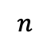
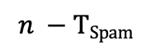
What is Spam?
Any transaction that does not change the final state of a block in terms of balance and storage when removed is considered spam.
T₁
T₁
T_{Spam}
T₂
T₂
T₃
T₃
$$n$$
$$n −TSpam$$
state(n)= state(n – T_{Spam})
36

Slide 37
Spam Arbitrage Examples
T₁
T₁
T_{Spam}
Reads state
Reverts
T_{Spam}
Reads state
Does not revert
T₂
T₂
T₃
T₃
Reverted Arbitrage Spam Transactions
Non-Reverted Arbitrage Spam Transactions
37

Slide 38
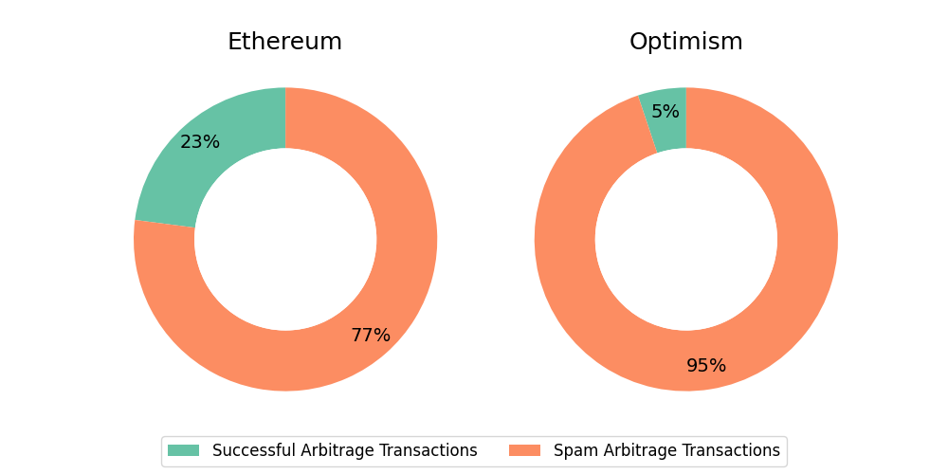
Successful Arbitrages
Larger number of spam arbitrage transactions on Optimism
38

Slide 39
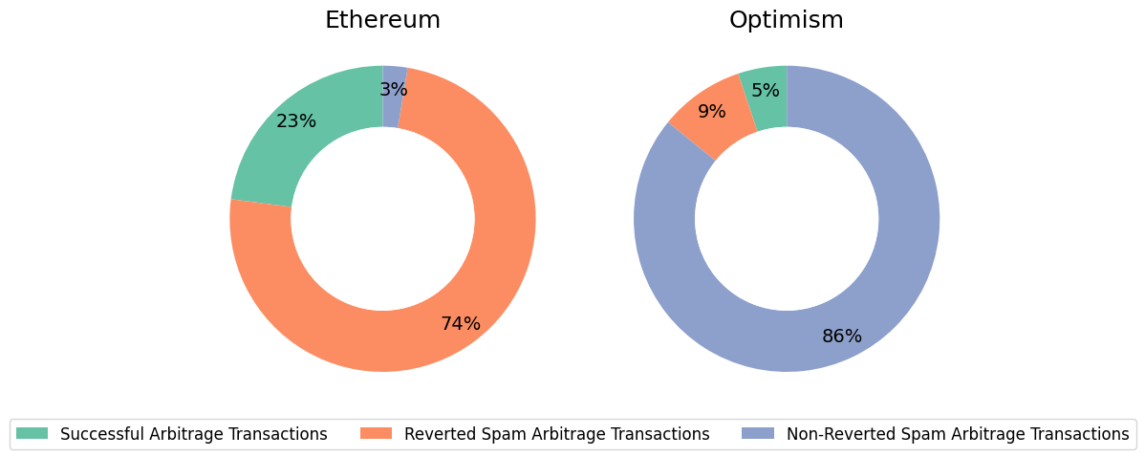
Reverted vs Non-Reverted
Optimism has a significantly larger number of non-reverting arbitrage transactions
39

Slide 40
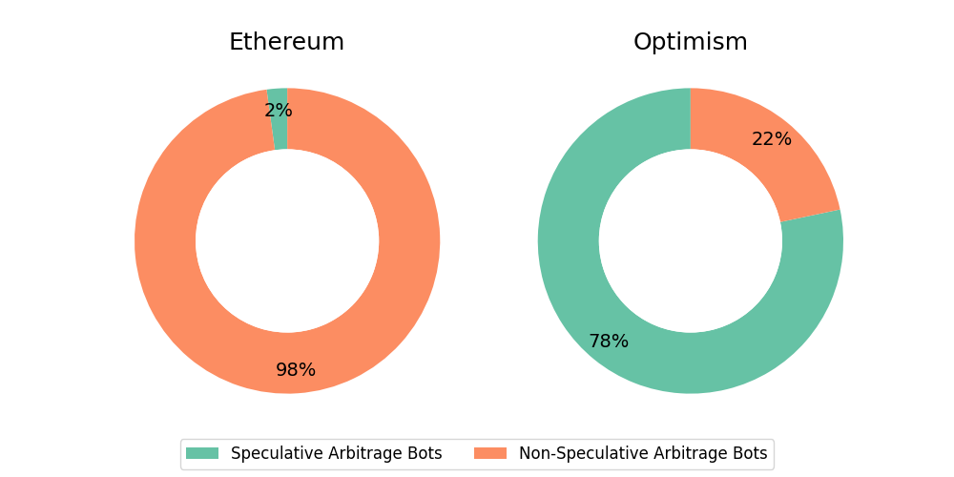
Speculative vs Non-Speculative - Bots
Optimism has a significantly larger number of speculative arbitrage bots
40

Slide 41
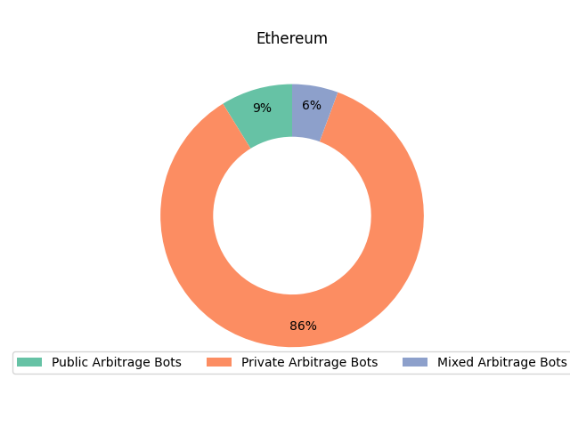
Private Mempool Usage - Bots
Most arbitrage bots on Ethereum operate via private mempools
41

Slide 42
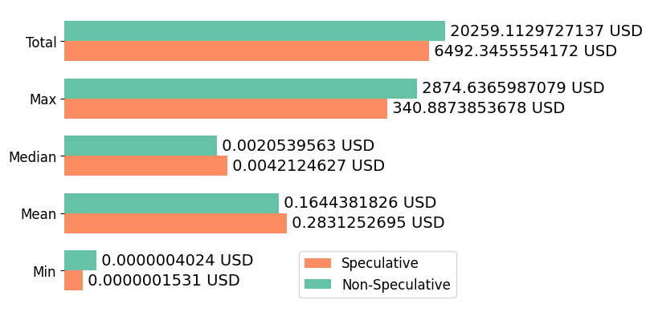
Speculative vs Non-Speculative Profits
On average speculative arbitrages are more profitable than non-speculative arbitrages
42

Slide 43
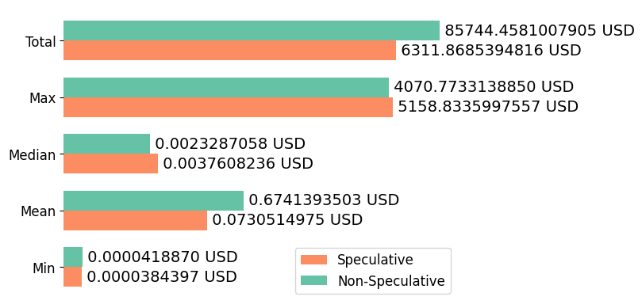
Speculative vs Non-Speculative Costs
On average speculative arbitrages are cheaper than non-speculative arbitrages
43

Slide 44
The Future of MEV
…2026?

Slide 45


Sandwiching Revisited
T₁
T_{A1}
T₁
T_{A1}
T_{A2}
T_{V}
Execution Order
T_{V}
Victim
T_{A2}
Sandwicher
…
…
Mempool
45

Slide 46
Cross-Layer Sandwiching Strategy S₁ (Classical Sandwiching)
Layer-1
Layer-2
T_{A1}
T_{A2}
Sandwicher
T₁
T₁
Execution Order
T_{A1}
T_{V}
Execution Order
T_{A1}
T_{V}
T_{A2}
…
T_{V}
Victim
T_{A2}
Bridge Smart Contract
…
Sequencer
…
Mempool
…
…
…
…
L1 Blocks
L2 Blocks
46

Slide 47
Cross-Layer Sandwiching Strategy S₂ (Hybrid Sandwiching)
Layer-1
Layer-2
T_{A1}
T_{A2}
Sandwicher
T₁
T₁
Execution Order
T_{A1}
T_{V}
Execution Order
T_{A1}
T_{V}
…
T_{A2}
…
T_{V}
Victim
…
Bridge Smart Contract
…
Sequencer
Mempool
…
…
…
…
L1 Blocks
L2 Batches
47

Slide 48



Cross-Layer Sandwiching Strategy S₃ (Speculative Sandwiching)
Layer-1
Layer-2
T_{A1}
Sandwicher
T_{A2}
T₁
T₁
Execution Order
T_{V}
Execution Order
T_{A1}
…
T_{V}
…
T_{A2}
…
Victim
…
Bridge Smart Contract
Sequencer
Mempool
…
…
…
…
L1 Blocks
L2 Blocks
48

Slide 49
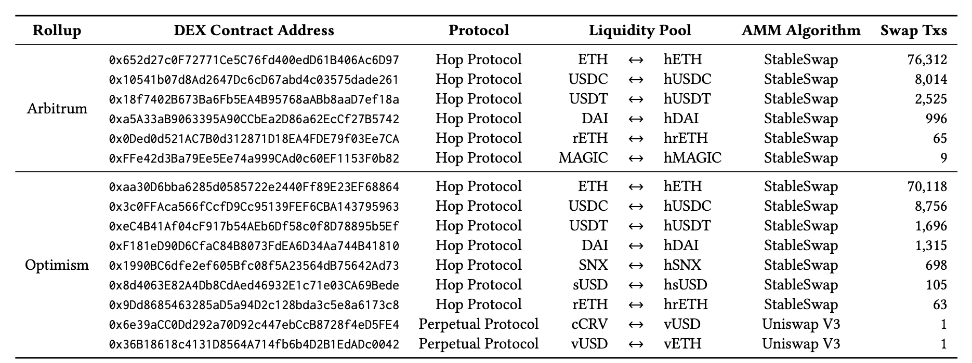
Assumption 1: Users Emit L2 Swaps via L1
Found 170,674 L2 transactions emitted via L1 performing swaps (trades)
49

Slide 50
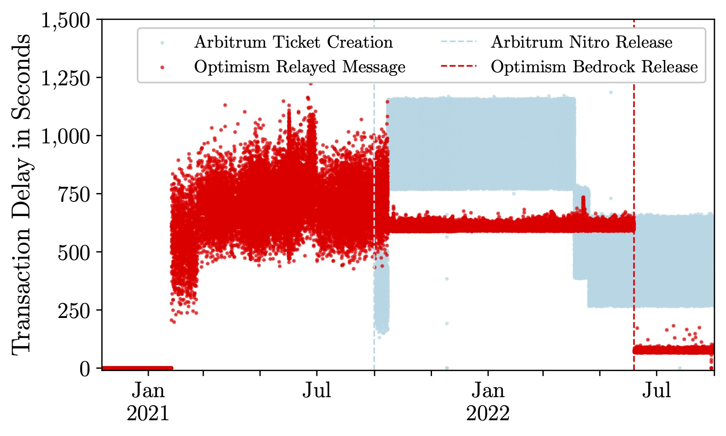
Assumption 2: Transaction Inclusion Delays
Arbitrum
Nitro
Mean 798 seconds, Median 868 seconds
Optimism
Pre-Bedrock
Mean 583 seconds, Median 609 seconds
Post-Bedrock
Mean 83 seconds, Median 74 seconds
50

Slide 51
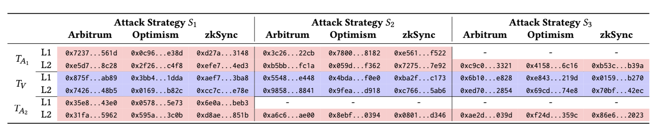
Validation on Testnet
Sepolia testnet transactions for each cross-layer sandwich attack strategy across Arbitrum, Optimism, and zkSync
51

Slide 52

Simulated Profit Estimation on Mainnet
Nearly 2M USD profit across Arbitrum and Optimism combined
Strategy S3 is more effective for attackers with lower capital
Optimism is more profitable for attackers with lower capital
52

Slide 53
Conclusion

Slide 54
Conclusion
MEV creates centralization pressures
MEV is omnipresent across Layer-1 and Layer-2
MEV dynamics are entirely different across Layer-1 and Layer-2
Layer-2 rollups suffer from inefficient MEV extraction
Inefficient MEV extraction drives Layer-2 spam
Future searchers will exploit side-channel leakage to extract MEV
54

Slide 55
Questions?
christof.torres@tecnico.ulisboa.pt

